Slide 1
Understanding and Using Imperfect Curricular Materials
Core Advocates Monthly Webinar
Tuesday, August 16, 2016
7:00 - 8:00 EDT
The webinar will begin shortly. You may wish to download the handouts (check the tab on your webinar control panel) while you wait.

Slide 2
Introductions
Your hosts from the Field Impact Team
Sandra Alberti, Director
Janelle Fann, Project Manager
Jennie Beltramini, Teacher Engagement Manager
Joanie Funderburk, Manager of Professional Learning
This Month’s Guests
Cathy Schmidt, SAP ELA/Literacy Team
Marni Greenstein, SAP Math Team
Haile Bennett, SAP Digital Team
Kate Linnehan, Core Advocate
Mandy Polen, Core Advocate

Slide 3
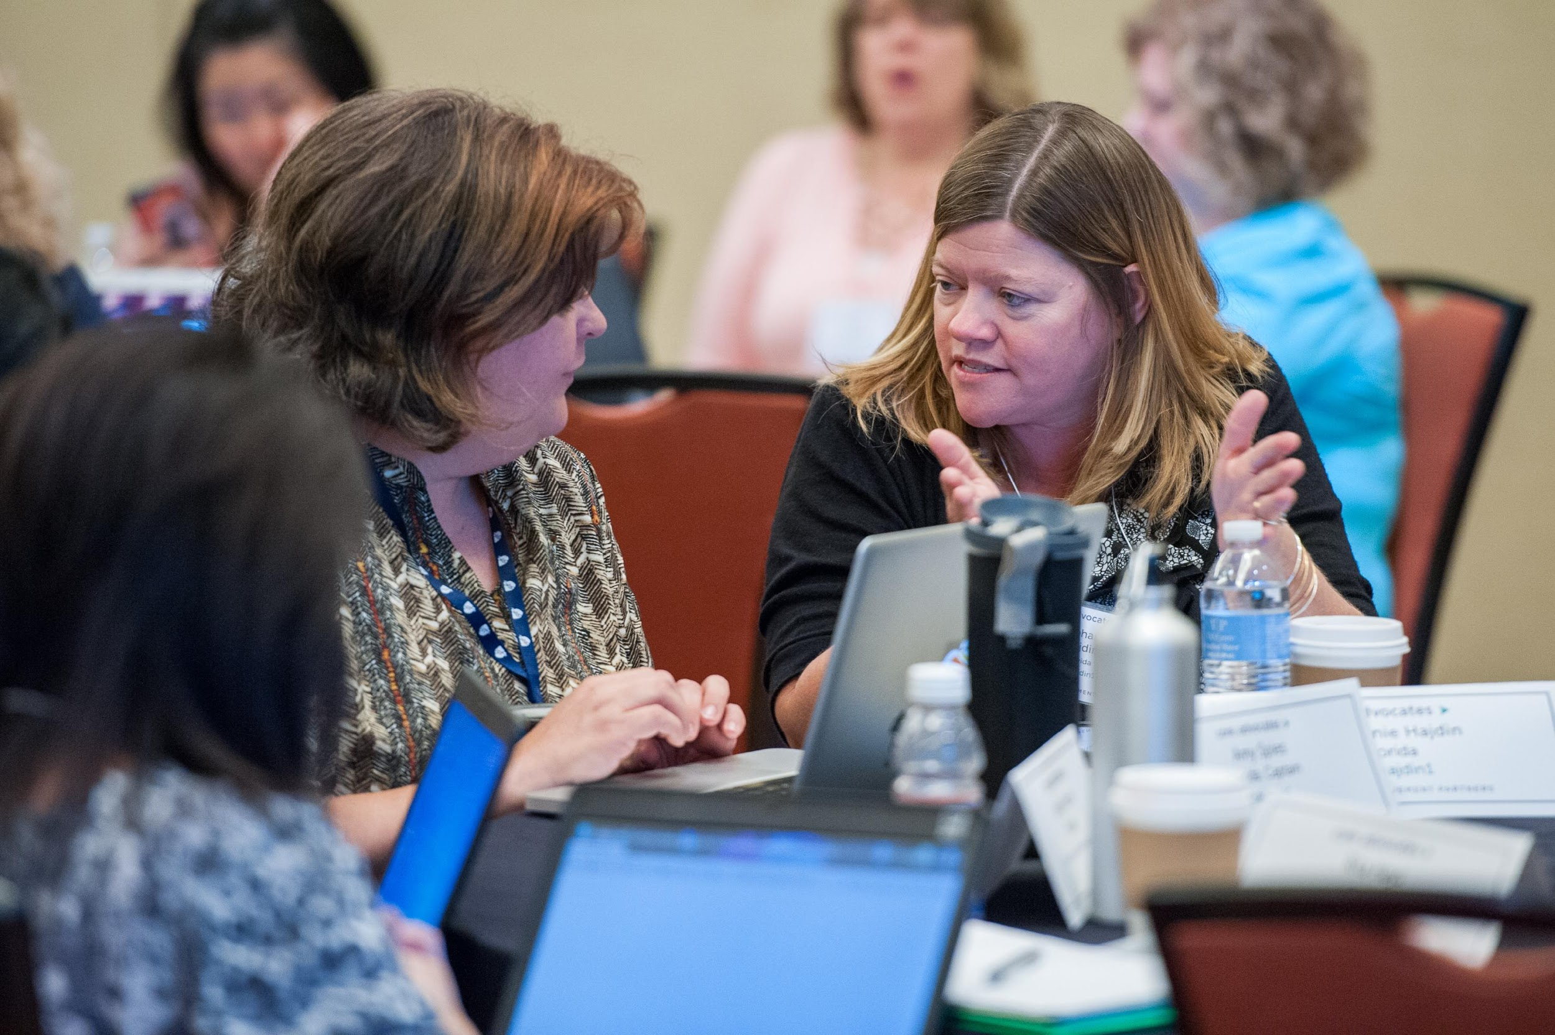
Who are Core Advocates?
Core Advocates are educators who:
  Believe in the potential of the CCSS to prepare all students for college and careers;
  Are eager to support their colleagues and communities in understanding and advocating for the CCSS and CCSS-aligned instruction;
  Understand and embrace the shifts in instruction and assessment required by the CCSS

Slide 4

To learn more about Core Advocates…
Contact Jennie Beltramini (jbeltramini@studentsachieve.net ) or Joanie Funderburk (jfunderburk@studentsachieve.net)
Complete this survey to join our database (and mailing lists): http://bitly.com/joincoreadvocates
Visit our website: www.achievethecore.org

Slide 5

For Tweeters…
Please feel free to tweet during and after the webinar using #coreadvocates
@achievethecore
@JoanieFun, @salberti, @JennieBeltro, @cathsch256, @math_marni, @MandyPolen

Slide 6
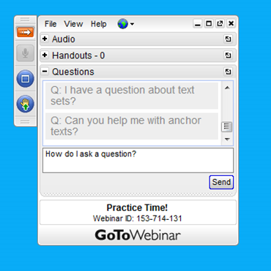
Webinar protocols
During the webinar
– Accessing Documents
– Questions option
– Polling
After the webinar
– Survey
– Access to recorded webinar

Slide 7
Goals of the webinar
Learn about resources that will help you know how well-aligned your curricular materials are.
Get ideas for what to do with your materials if they are not perfectly aligned.
Get ideas from other educators about how they are working with imperfect materials.

Slide 8
How do I know how well-aligned my materials are?

Slide 9
Poll:
Has your district or school reviewed your current instructional resources for alignment to the Standards and the Shifts?

Slide 10
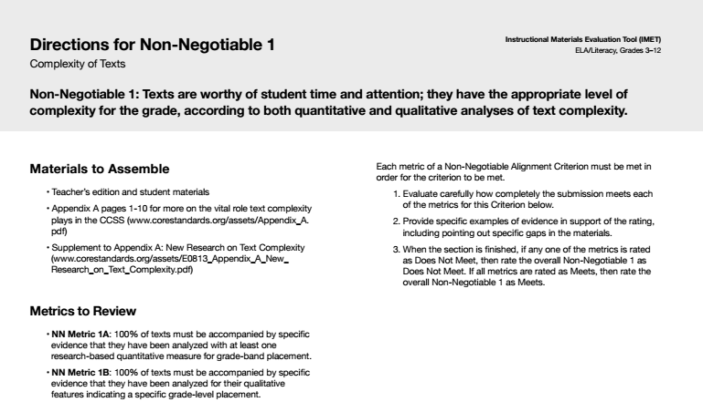
Tools for Reviewing: IMET
SAP’s Instructional Materials Evaluation Tool (IMET)
  A tool for evaluating a comprehensive textbook or textbook series for alignment to the Shifts and major features of the CCSS.
  For use with ELA/literacy materials for grades K-2 or 3-12 and for mathematics materials K-8 or high school

Slide 11
Tools for Reviewing: IMET
Use this tool to:
  Inform decisions about purchasing
  Evaluate previously purchased materials to identify necessary modifications
  Build understanding of what aligned materials look like
Professional Development Modules for math and ELA to build understanding of the IMET and materials’ alignment

Slide 12
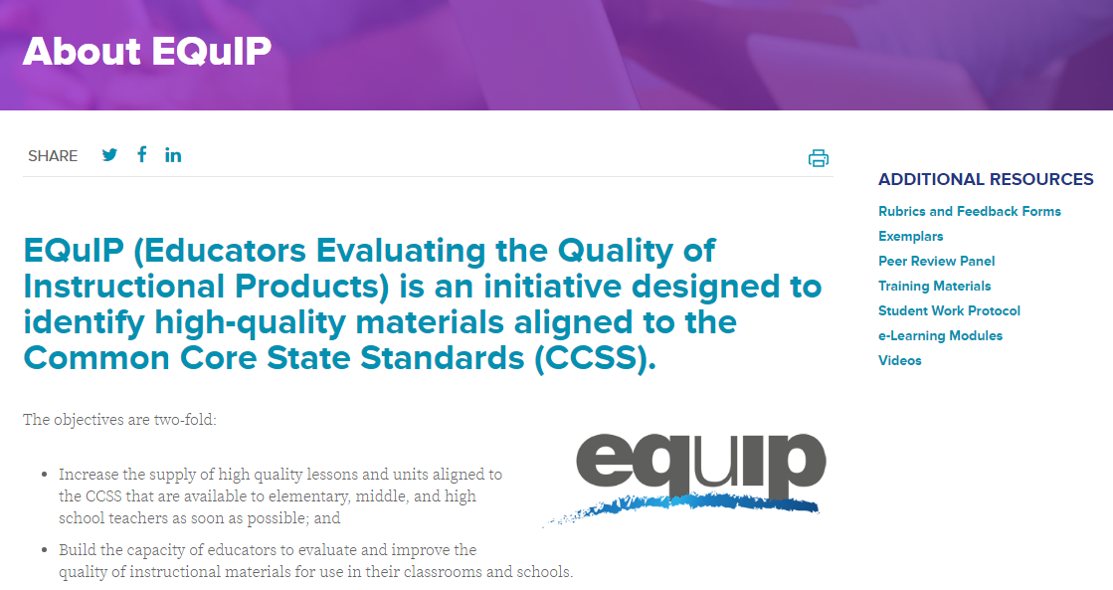
Tools for Reviewing: EQuIP Rubric
Achieve’s Educators Evaluating the Quality of Instructional Products (EQuIP) Rubric
  Rubrics and feedback forms for math and ELA units
  162 Exemplar units with corresponding completed reviews
  Student Work protocol

Slide 13


Accessing Completed Reviews
Ed Reports
Math Reviews
  Twenty-six K-8 reviews
  Five high school reviews
ELA Reviews
  in progress
Louisiana Believes
  Comprehensive reviews of ELA and math materials

Slide 14
Question:
How have you used the IMET, EdReports, LA Believes or the EQuIP rubrics?
Please use the Questions tab on your control panel to respond.

Slide 15
My materials are not perfectly aligned! Now what?

Slide 16
General Guidance on Adapting Materials
SAP worked with Illustrative Mathematics to pilot a project supporting districts in making adaptations to their current materials
Processes, outcomes and templates that can be used to adapt any materials
All materials available through the Aligned blog:
  http://achievethecore.org/aligned/outcomes-of-the-adaptation-process/

Slide 17
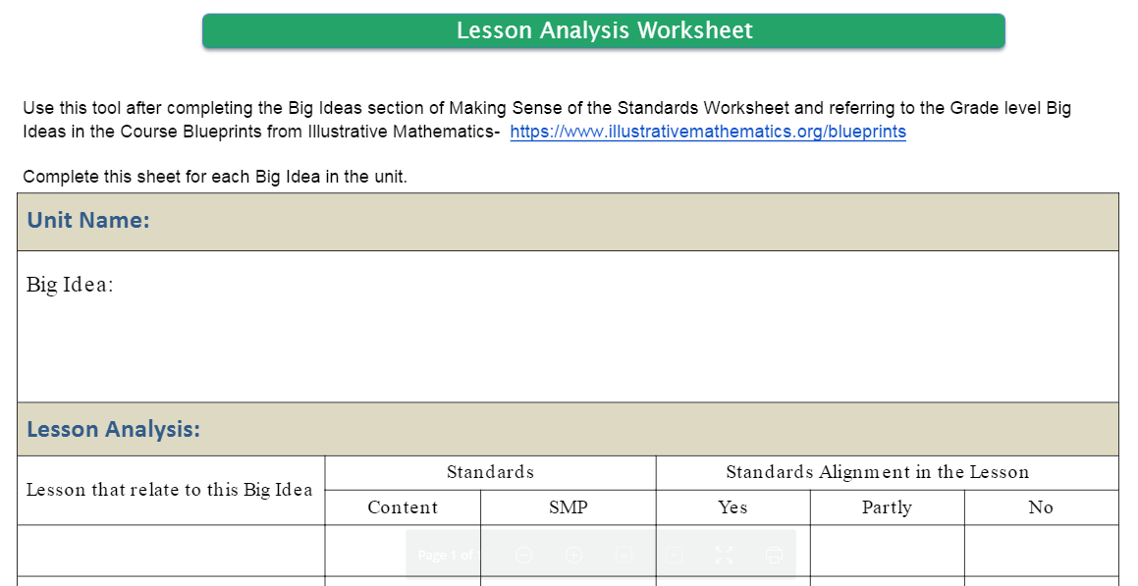
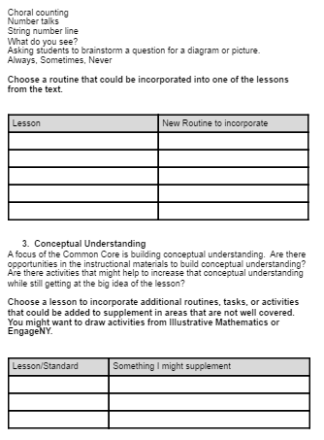
Tools for planning adaptations

Slide 18
Materials Adaptation Project (MAP): GO Math! (K-5)
Work done in partnership with districts currently using GO Math!
How can Go Math! be used in a way that is more aligned to the Shifts and Standards?
  program- and grade-level specific guidance to help with both long-term and daily planning
  “Fluency Resources” available at each grade
Coming soon: Assessment Guidance for each grade

Slide 19
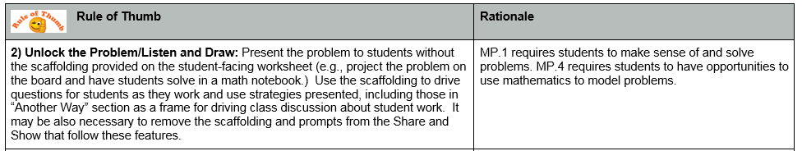
Example: Program Guidance

Slide 20
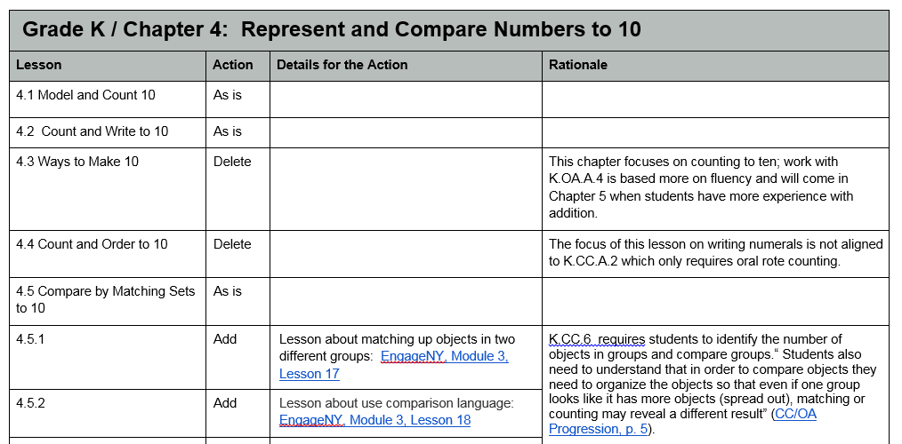
Example: Chapter Guidance

Slide 21
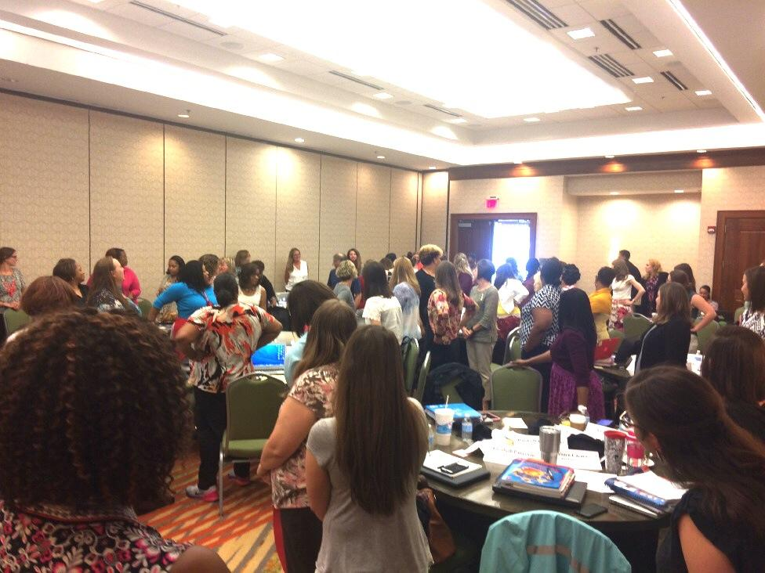
Materials Adaptation Project: Journeys 2014
Brought educators together to explore:
How can we use critical features of alignment to guide more effective use of the ‘traditional’ basal?
What resources are available to support the work of adapting materials?

Slide 22

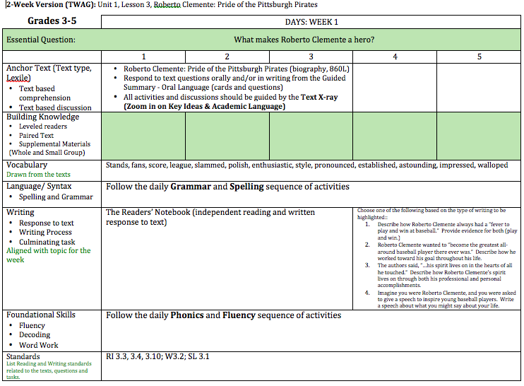
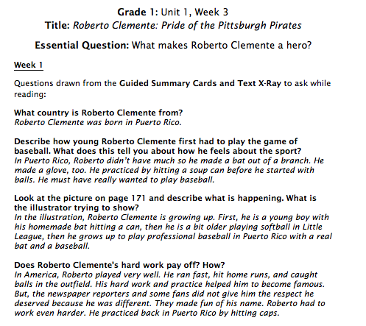
Week 1: Close Reading

Slide 23

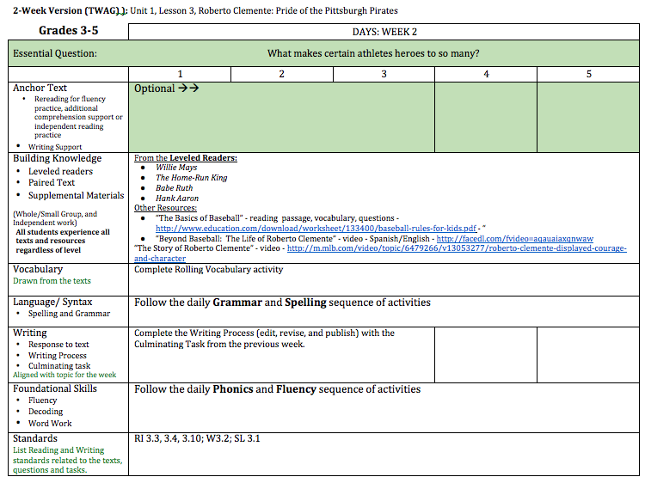
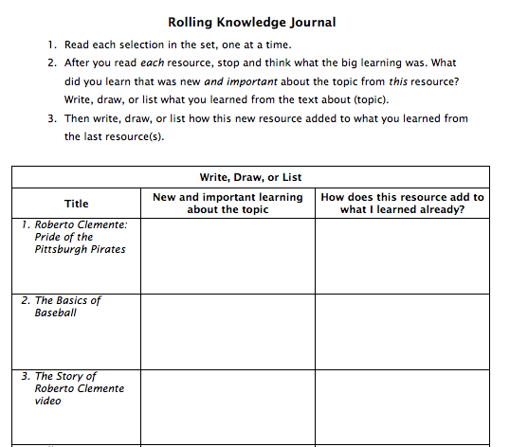

Week 2: Building Knowledge

Slide 24

Rules of Thumb
How should teachers use the features of the book to make instruction more aligned?
Any features to elevate?
Any features to ignore?

Slide 25

Recommendations for adapting materials
Analyze to identify strengths and identify gaps
Consider existing resources that can be adapted
Supplement and streamline as necessary
Provide rationale for the adaptations to build understanding for implementation

Slide 26
Instructional Advocacy – A Definition
Grounded in a firm understanding of the Shifts, educators owning, supporting, and promoting the resources, tools, and practices that create learning environments in which students develop college- and career- readiness.

Slide 27
Question:
How could you use one of the alignment tools or the MAP materials to enhance Instructional Advocacy in your school or district?
Please use the Questions tab on your control panel to respond.

Slide 28
How are other educators using their imperfect materials?

Slide 29
Core Advocate Newsletter Responses
I use EdReports.org to help me determine where I can strengthen my math curriculum. Trusting that EdReports has already completed the "leg work" of alignment, I can focus on instruction and analysis of student progress across the standards.
  Tiffany Gruen, KY
TWEAKING! There are some good materials out there... with just a few minor adjustments they can be perfect for helping my students have success!
  Paula Hulme, WA

Slide 30
Core Advocate Newsletter Responses
As a math teacher, I first dive into the standards that I want to teach in a unit. It is important to really unpack the core understandings required by the standard. I then take my math textbook or supplemental material and look for the corresponding lessons or activities that truly focus on the requirements of the standard. I then build the lesson surrounding the standard and use the textbook and supplemental materials as reference or practice material.
  Ann Marie VanSickle, NJ

Slide 31
Core Advocate Newsletter Responses
I share these resources with math teachers as they make decisions about instruction:
Focus by Grade Level documents from Achieve the Core
The Standards (of course!)
The progressions of the CCSS-M
Tools specific to our curricular resources
  Jamie Garner, CA

Slide 32

Our Guest: Mandy Polen
K-4 Instructional Coach
Mad River Local Schools
Dayton, OH

Slide 33

Our Guest: Kate Linnehan
Reading Interventionist
Pleasant Valley School
Mullica Hill, NJ

Slide 34
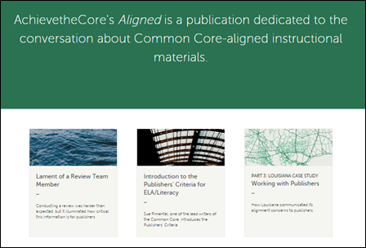
Aligned blog: achievethecore.org/aligned
SAP’s blog dedicated to instructional materials discussions
Advice on how to supplement, adapt, review, and select instructional materials
Range of voices from classroom teachers to state leaders to subject matter experts, all sharing their personal experiences and advice.
Email topic suggestions to ccssmaterials@studentsachieve.net

Slide 35
Your Questions?

Slide 36
Poll:
Which resource discussed tonight do you want to explore further?

Slide 37

Tonight’s Big Idea
Although it is important to purchase good materials, teachers don’t have to wait for that to happen.
There are resources to make good use of existing materials, by reviewing and/or adapting them for effective planning and implementation of the Standards.

Slide 38
Here’s what YOU can do next
Use the IMET with a team in your setting to review your existing materials
Use the MAP documents with your Go Math or Journeys instructional materials
Use one or more EQuIP rubrics with a team in your setting to review a unit, lesson, or student work
Access the high-level EdReports findings for your materials, and discuss next steps with your colleagues

Slide 39
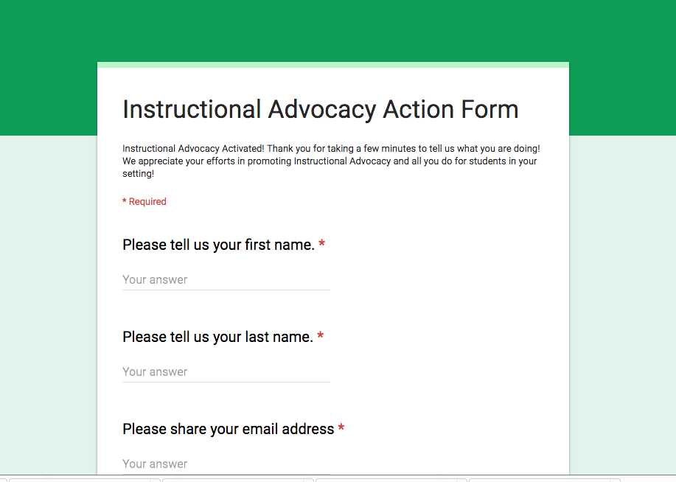
Tell us about your work

Slide 40
Please join us again next month!
Building a Deeper Understanding of the Math Standards in PLCs
Wednesday*, September 7, 2016 7:00 EDT
Register Here: https://attendee.gotowebinar.com/register/6460516295054418690
*Starting in September, Core Advocate Webinars move to Wednesday evenings (first Wednesday of each month)

Slide 41
Thank You!

